Slide 1

Inheritance in C++

Slide 2
Agenda
What is Inheritance and why to use it?
Relationship between base class and derived class.
Protected member access specifier
Destructor Introduction
The use of constructors and destructors in inheritance hierarchies.
The order in which constructors and destructors are called in inheritance hierarchies
The differences between public, protected and private inheritance
Self Review Questions and Exercises

Slide 3
The idea behind Inheritance
A form of Software Reuse.
Idea is that instead of redefining members of a new class, make use of the capabilities of the existing class, if they have some sort of relationship,
Software Reuse saves times during program development, by making use of proven, high quality software.

Slide 4
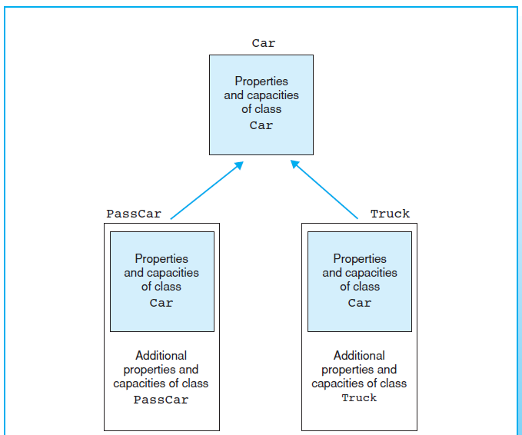

Slide 5
Base Class and Derived Class
When a new class is created, instead of redefining it’s data member and functions again, we specify that it instead inherit the members of the existing class.
The class whose members are used is known as the Base Class.
Base Class is also known as the Parent Class.
The class which uses the members of it’s Parent Class is known as Derived Class.

Slide 6
Is-a relationship
Represents Inheritance
Object of derived class can also be treated as an object of it’s base class.
E.g. Car is a vehicle, so any attribute and behaviors of a Vehicle are also attributes and behaviors of a Car.
Has-a relationship
Represents Composition
Object contains one or more objects of other classes as members.
Car has many components - It has a Steering Wheel, a Brake, A transmission etc.

Slide 7
Class Hierarchies
Inheritance relationships form class hierarchies.
A base class establishes a hierarchical relationship with its derived classes.
Once a class is part of an inheritance relationship, they become affiliated with other classes.
A class can either become a base class - supplies it’s members to other class or a derived class - inherits its member from other classes, or both.
Although classes can exist independently, once they’re

Slide 8
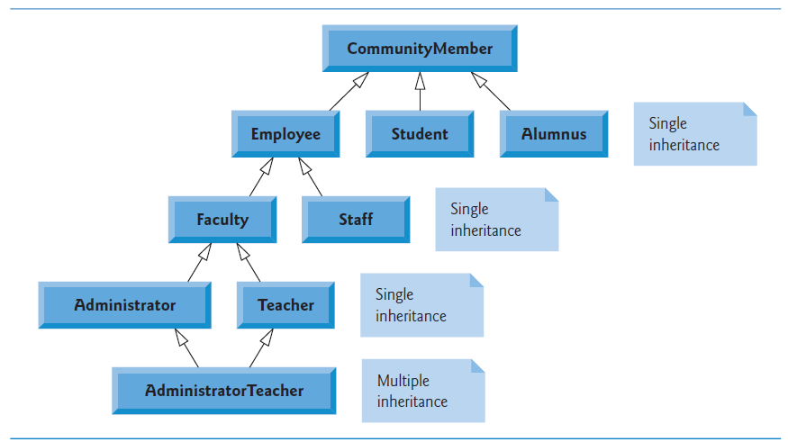
E.g -Community Member Class Hierarchy

Slide 9
Community Member Hierarchy Explained
CommunityMember consists of Employee, Student and Alumni (Each part of class Alumnus).
Employees are either Faculty or Staff.
Faculty are either Teacher or Administrator.
Some Administrators are also Teachers.

Slide 10
Community Member Hierarchy Explained
Single Inheritance: A class is derived from one base class
Multiple Inheritance: A derived class inherits simultaneously from two or more based classes (possibly unrelated).
Each arrow in the above diagram represents is-a relationship.
By following the arrows, we can state “an Employee is a CommunityMember” and “a Teacher is a Faculty Member”
CommunityMember is direct base class for Employee, Student and Alumni, while it is indirect base class for other derived classes.

Slide 11
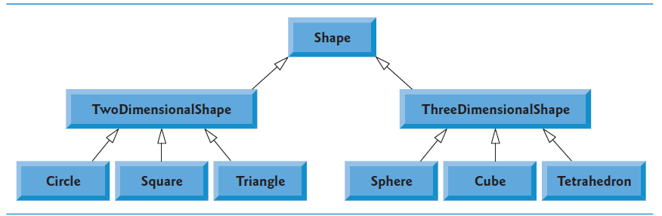
Shape Class Hierarchy

Slide 12
Shape Class hierarchy
Shape is the Base Class, which sits at the top of this hierarchy.
Classes TwoDimensionalShape and ThreeDimensionalShape derive from base class Shape
A Shape is a TwoDimensionalShape or is a ThreeDimensionalShape.
Third level of this hierarchy contains more specific types of TwoDimensionalShapes and ThreeDimensionalShapes.
By following the arrows from the bottom of the diagram upwards to the topmost base class in this hierarchy to identify several is-a relationships.
For instance, a Triangle is a TwoDimensionalShape and is a Shape, while a Sphere is a ThreeDimensionalShape and is a Shape.

Slide 13
RelationShip Between Base Class and Derived Class
Example of an inheritance hierarchy containing types of employees in a company’s payroll application to discuss the relationship between a base class and a derived class.
Commission employees (who will be represented as objects of a base class) are paid a percentage of their sales, while base-salaried commission employees (who will be represented as objects of a derived class) receive a base salary plus a percentage of their sales

Slide 14
Base Class : CommissionEmployee
CommissionEmployee class defines method for the setting the firstname, lastname, ssn, gross sales and commission rates for an employee.
The constructor for this class do not use the member initializer syntax, to show that how private and protected specifiers affect the members of the derived class.
Method for gross sales and commission rates are validated.
This class also calculates the earnings of an employee, by multiplying the amount of gross sales and commission rate.

Slide 15
Class: BasePlusCommissionEmployee
This class is implemented from the scratch, without using inheritance.
This class also contains the method to initialize the employees first name, last name, ssn, gross sales and commission rate.
In addition to this, the class also contains a method to set the base salary of the employee.
In this case, earning of an employee would be computed by adding the base salary of the employee with the product of commission rate and gross sales.

Slide 16
Similarities between CommissionEmployee and BasePlusCommissionEmployee
If the code is observed, then it can be found that the code for CommissionEmployee and BasePlusCommissionEmployee classes are similar.
The only difference which remains is the way, earnings for employees is being calculated, in both the classes.
The problem is that this approach is error prone and time consuming, and lot of similar tasks has been re-implemented again.
By using inheritance, it’s possible to modify the code, and save time, along with making the code to look neat and clean.
The idea is to ensure that implementation remains hidden from the users, while interface retains it’s abstraction.

Slide 17
Inheritance: BasePlusEmployeeClass
In order to inherit the members of CommissionEmployee class,add the following code to the derived class BasePlusEmployeeClass
The colon : indicates the inheritance.
Access Specifier public indicates the type of inheritance.
The derived class BasePlusEmployeeClass will inherit all the member of the base class CommissionEmployee, except for the constructor. (and the destructor too)
Derived Classes will have their own constructors and destructors.
class BasePlusCommissionEmployee :public CommissionEmployee

Slide 18
Inheritance:Derived Class Constructor
The following lines of code shows the base-class initializer syntax
Uses a member initializer to pass arguments to the base-class (CommissionEmployee) constructor.
C++ requires that a derived-class constructor call its base-class constructor toinitialize the base-class data members that are inherited into the derived class
If BasePlusCommissionEmployee’s constructor did not invoke class CommissionEmployee’s constructor explicitly, C++ would attempt to invoke class CommissionEmployee’s default constructor implicitly
But the class does not have such a constructor, so the compiler would issue an error.
Also, CommissionEmployee does explicitly include a constructor, so a default constructor is not provided
BasePlusCommissionEmployee::BasePlusCommissionEmployee(const string& first, const string& last, const string& ssn, double sales, double rate, double salary) :CommissionEmployee(first, last, ssn, sales, rate)

Slide 19
Including Base Class Header in Derived Class Header
For the derived class to use the base class’s name , compiler must know that base class exists. CommissionEmployee.h header files does this work.
By including the base class’s definition, compiler is able to determine the amount of memory needed to store the data member of base class, which has become part of derived-class object, and compute the total size of the derived-class object.
Allow the compiler to determine whether the derived class uses the base class’s inherited members properly. the compiler uses the base-class header to determine that the data members being accessed by the derived class are private in the base class. Since these are inaccessible to the derived class, the compiler generates errors.
The compiler also uses the base class’s function prototypes to validate function calls made by the derived class to the inherited base-class functions

Slide 20
Access Specifier:Protected
The present code, would not execute properly, as Derived Class do not have access to the private member of the Base Class.
Base Class private members are accessible to itself and to the friends of that base class.
This problem can be solved by making members of Base Class Protected.
Using protected access offers an intermediate level of protection between public and private access.

Slide 21
Protected Access Specifier - Problems
By inheriting protected data members, performance improves slightly as there is no overhead of calls to set or get member functions.
But using protected data members creates two serious issues.
First Problem is that Object remains in an inconsistent state.
Derived Class object can set the value of base class’s protected data member without using the member function.
This allows to assign an invalid value to the protected data members, and therefore, objects end up in an inconsistent state.

Slide 22
Protected Access Specifier - Problems
E.g. CommissionEmployee’s data member grossSales declared as protected, a derived-class object can assign a negative value to grossSales.
Second issue is the Dependency on the base class implementation.
Derived classes should depend only on the base-class services (i.e., nonprivate member functions) and not on the base-class implementation.
If base class has protected data members, and it’s implementation changes, then all derived classes of that base class may need to be modified.
For Example, if the names of data members were changed to first and last, from firstName and lastName in the base class, then the derived classes, which refers to these base class data members directly, also needs to be modified.

Slide 23
Protected Access Specifier - Problems
Such software is fragile or brittle - minor change in base class can “divide” derived-class implementation.
Base Class implementation must be changed, by providing same services to the derived class.
Howerver, if base class service change , derived class also needs to be reimplemented – good object oriented design attempts to avoid this.
It’s appropriate to use the protected access specifier when a base class should provide a service (i.e., a non-private member function) only to its derived classes and friends.
Declaring base-class data members private (as opposed to declaring them protected) enables you to change the base-class implementation without having to change derived class implementations.

Slide 24
CommissionEmployee–BasePlusCommissionEmployee Inheritance Hierarchy Using private Data
In order to use the best software engineering practice, declare the data members of base class private.
In this example, the data members of class CommissionEmployee will be declared private.
Derived Class (BasePlusCommissionEmployee) will manipulate the private data members by invoking the non-private member functions of the Base Class.
Class’s private data members are accessed by calling the set and get member functions.
if the data members in the base class are renamed, earnings() and print() functions will not require any modification.
Only the Set() and Get() member function need to be modified.

Slide 25
BasePlusCommissionEmployee Class
Derived Class BasePlusCommissionEmployee inherits CommissionEmployee’s public member functions and can access the private base-class members via the inherited member functions.
Member functions earnings() and print(), each invoke member function getBaseSalary to obtain the base salary value, rather than accessing baseSalary directly.
This insulates earnings and print from potential changes to the implementation of data member baseSalary.
For example, if we decide to rename data member baseSalary or change its type, only member functions setBaseSalary and getBaseSalary will need to change.

Slide 26
BasePlusCommissionEmployee Member Function earnings
Class BasePlusCommissionEmployee’s version of earnings obtains the portion of the employee’s earnings based on commission alone by calling base-class CommissionEmployee’s earnings function with the expression CommissionEmployee::earnings().
BasePlus-CommissionEmployee’s earnings function then adds the base salary to this value to calculate the total earnings of the employee
Syntax used to invoke a redefined baseclass member function from a derived class—place the base-class name and the scope resolution operator (::) before the base-class member-function name.
This member-function invocation is a good software engineering practice
If an object’s member function performs the actions needed by another object, we should call that member function rather than duplicating its code body.
By having BasePlusCommissionEmployee’s earnings function invoke CommissionEmployee’s earnings function to calculate part of a BasePlusCommissionEmployee object’s earnings, we avoid duplicating the code and reduce code-maintenance problems.

Slide 27
BasePlusCommissionEmployee Member Function print
BasePlusCommissionEmployee’s print function redefines class CommissionEmployee’s print function to output the appropriate base-salaried commission employee information
The new version displays part of a BasePlusCommissionEmployee object’s information (i.e., the string "commission employee“ and the values of class CommissionEmployee’s private data members) by calling CommissionEmployee’s print member function with the qualified name CommissionEmployee:: print()
BasePlusCommissionEmployee’s print function then outputs the remainder of a BasePlusCommissionEmployee object’s information (i.e., the value of class BasePlusCommissionEmployee’s base salary).

Slide 28
Destructors
Another type of special member function
Naming Convention: tilde character followed by the class name
A destructor is a complement to constructor
May not specify parameters or return type.
A class’s destructor is called implicitly when an object is destroyed.
For example, when program execution leaves the scope in which object was instantiated, object is destroyed.
Destructor does not release the object’s memory – it performs termination housekeeping before the object’s memory is reclaimed, which can be re-used to hold new object.
Every class has one destructor.

Slide 29
When the Constructors and Destructors are Called?
Compiler calls Constructors and Destructors implicitly.
The order in which these function calls occur depends on the order in which execution enters and leaves the scopes where the objects are instantiated
As a general rule, destructors are called in the reverse order of the corresponding calls.
However, storage classes of objects can alter the order in which destructors are called.

Slide 30
Constructors and Destructors for Objects in Global Scope
Constructors are called for objects defined in global scope (also called global namespace scope) before any other function (including main) in that program begins execution (although the order of execution of global object constructors between files is not guaranteed).
The corresponding destructors are called when main terminates.
Function exit forces a program to terminate immediately and does not execute the destructors of local objects
The exit function often is used to terminate a program when a fatal unrecoverable error occurs.
Function abort performs similarly to function exit but forces the program to terminate immediately, without allowing the destructors of any objects to be called
Function abort is usually used to indicate abnormal termination of a program.

Slide 31
Constructors and Destructors for Local Objects
The constructor for an local object is called when execution reaches the point where that object is defined
The corresponding destructor is called when execution leaves the object’s
scope (i.e., the block in which that object is defined has finished executing).
Constructors and destructors for local objects are called each time execution enters and leaves the scope of the object.
Destructors are not called for local objects if the program terminates
with a call to function exit or function abort.

Slide 32
Constructor and Destructors for static Local Objects
The constructor for a static local object is called only once, when execution first reaches the point where the object is defined
The corresponding destructor is called when main terminates or the program calls function exit.
Global and static objects are destroyed in the reverse order of their creation
. Destructors are not called for static objects if the program terminates with a call to function abort.

Slide 33
Constructor in Derived Classes
Instantiating a derived-class object begins a chain of constructor calls in which the derived-class constructor, before performing its own tasks, invokes its direct base class’s constructor either explicitly (via a base-class member initializer) or implicitly (calling the base class’s default constructor).
If the base class is derived from another class, the base-class constructor is required to invoke the constructor of the next class up in the hierarchy, and so on.
The last constructor called in this chain is the one of the class at the base of the hierarchy, whose body actually finishes executing first.
The most derived-class constructor’s body finishes executing last. Each base-class constructor initializes the base-class data members that the derived-class object inherits

Slide 34
Constructors and Destructors in CommissionEmployee and BasePlusCommissionEmployee class
When BasePlusCommissionEmployee object is created, the CommissionEmployee
constructor gets called.
The constructor of CommissionEmployee executes, as it is at the base of the hierarchy.
This constructor initializes the private data members of CommissionEmployee, that are part of BasePlusCommissionEmployee object.
Since class CommissionEmployee is at the base of the hierarchy, its constructor executes, initializing the private CommissionEmployee data members that are part of the BasePlusCommissionEmployee object.
When CommissionEmployee’s constructor completes execution, it returns control to BasePlusCommissionEmployee’s constructor, which initializes the BasePlusCommissionEmployee object’s baseSalary.

Slide 35
Destructors in Derived Classes
When a derived-class object is destroyed, the program calls that object’s destructor.
This begins a chain (or cascade) of destructor calls in which the derived-class destructor and the destructors of the direct and indirect base classes and the classes’ members execute in reverse of the order in which the constructors executed.
When a derived-class object’s destructor is called, the destructor performs its task, then invokes the destructor of the next base class up the hierarchy.
This process repeats until the destructor of the final base class at the top of the hierarchy is called. Then the object is removed from memory

Slide 36
Public, private and protected inheritance
A derived class can inherit it’s base class members through public, private or protected inheritance.
When deriving a class with protected inheritance, public and protected members of the base class become protected members of the derived class.
When deriving a class with private inheritance, public and protected members of the base class become private members (e.g., the functions become utility functions) of the derived class.
Private and protected inheritance are not is-a relationships.

Slide 38
Software Engineering with Inheritance
Object oriented programming facilitates software reuse, thus shortening development times and enhancing software quality.
By using inheritance, a new class is created from an existing one. This new class inherits data members and member functions of the existing class.
This new class can be customized to meet the needs by redefining base-class members and by including additional members.
The derived-class programmer does this in C++ without accessing the base class’s source code (the derived class must be able to link to the base class’s object code).
This powerful capability is attractive to software developers, who can develop proprietary classes for sale or license and make these classes available to users in object-code format

Slide 39
Software Engineering with Inheritance
Users then can derive new classes from these library classes rapidly and without accessing the proprietary source code.
The software developers need to supply the headers along with the object code
The availability of substantial and useful class libraries delivers the maximum benefits of software reuse through inheritance.
The standard C++ libraries tend to be general purpose and limited in scope.
There is a worldwide commitment to the development of class libraries for a huge variety of application arenas.

Slide 40
Self Review Exercises (Refer Diettel and Diettel Chapter 11)
Fill in the blanks in each of the following statements:
_______ is a form of software reuse in which new classes absorb the data and behaviors of existing classes and embellish these classes with new capabilities.
b) A base class’s ____________ members can be accessed in the base-class definition,
in derived class definitions and in friends of the base class its derived classes.
c) In a(n) ____________ relationship, an object of a derived class also can be treated as an
object of its base class.
d) In a(n) ____________ relationship, a class object has one or more objects of other classes as
members.
e) In single inheritance, a class exists in a(n) ______________ relationship with its derived classes.

Slide 41
f) A base class’s ______________ members are accessible within that base class and anywhere that the program has a handle to an object of that class or one of its derived classes.
g) A base class’s protected access members have a level of protection between those of public and _________ access.
h) C++ provides for ___________ , which allows a derived class to inherit from many base classes, even if the base classes are unrelated
i) When an object of a derived class is instantiated, the base class’s _________ is called implicitly or explicitly to do any necessary initialization of the base-class data members in the derived-class object.

Slide 42
(j) When deriving a class with public inheritance, public members of the base class
become ____________ members of the derived class, and protected members of the
base class _____________ become members of the derived class.
k) When deriving a class from with protected inheritance, public members of the base
class become ____________ members of the derived class, and protected members of
the base class become ____________ members of the derived class.
Inheritance. b) protected. c) is-a or inheritance (for public inheritance). d) has-a or composition or aggregation. e) hierarchical. f) Public g) private h) multiple inheritance. i) constructor. j) public, protected. k) protected, protected.

Slide 43
True or False
a) Base-class constructors are not inherited by derived classes.
b) A has-a relationship is implemented via inheritance.
c) A Car class has an is-a relationship with the SteeringWheel and Brakes classes.
d) Inheritance encourages the reuse of proven high-quality software.
e) When a derived-class object is destroyed, the destructors are called in the reverse order of the constructors.
Answers:
a) True
b) False. A has-a relationship is implemented via composition. An is-a relationship is implemented via inheritance.
c) False. This is an example of a has-a relationship. Class Car has an is-a relationship with class Vehicle.
d) True.
e) True.

Slide 44
Questions and Answers
(Composition as an Alternative to Inheritance) Many programs written with inheritance could be written with composition instead, and vice versa. Rewrite class BasePlusCommissionEmployee of the CommissionEmployee–BasePlusCommissionEmployee hierarchy to use composition rather than inheritance. After you do this, assess the relative merits of the two approaches for designing classes CommissionEmployee and BasePlusCommissionEmployee, as well as for object-oriented programs in general. Which approach is more natural? Why?
(Inheritance Advantage) Discuss the ways in which inheritance promotes software reuse, saves time
during program development and helps prevent errors.
3. (Protected vs. Private Base Classes) Some programmers prefer not to use protected access because they believe it breaks the encapsulation of the base class. Discuss the relative merits of using protected access vs. using private access in base classes

Slide 45
4. (Student Inheritance Hierarchy) Draw an inheritance hierarchy for students at a university similar to the hierarchy Use Student as the base class of the hierarchy, then include
classes UndergraduateStudent and GraduateStudent that derive from Student.
Continue to extend the hierarchy as deep (i.e., as many levels) as possible.
For example, Freshman, Sophomore, Junior and Senior might derive from UndergraduateStudent, and DoctoralStudent and MastersStudentmight derive from GraduateStudent.
After drawing the hierarchy, discuss the relationships that exist between the classes. [Note: You do not need to write any code for this exercise.
5. (Quadrilateral Inheritance Hierarchy) Draw an inheritance hierarchy for classes Quadrilateral, Trapezoid, Parallelogram, Rectangle and Square. Use Quadrilateral as the base class of the hierarchy. Make the hierarchy as deep as possible.
6. Attempt Exercise 11.9 and 11.10.

